Slide 1
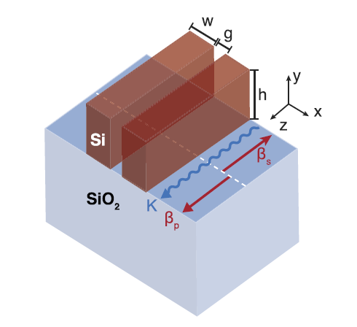
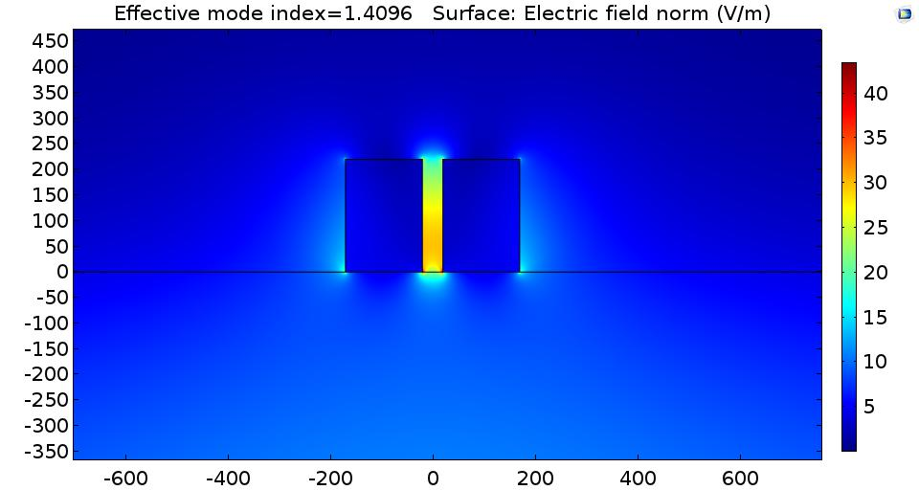
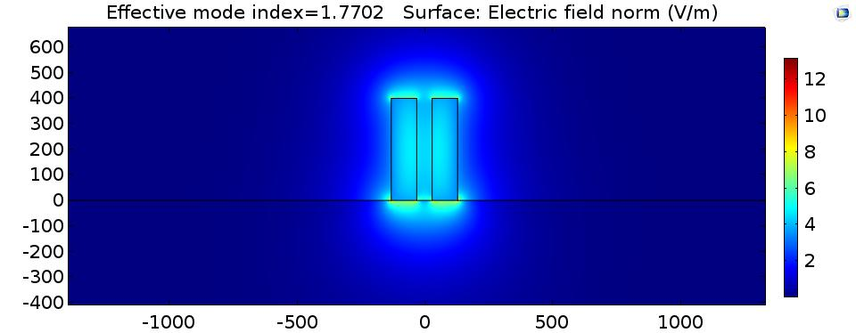
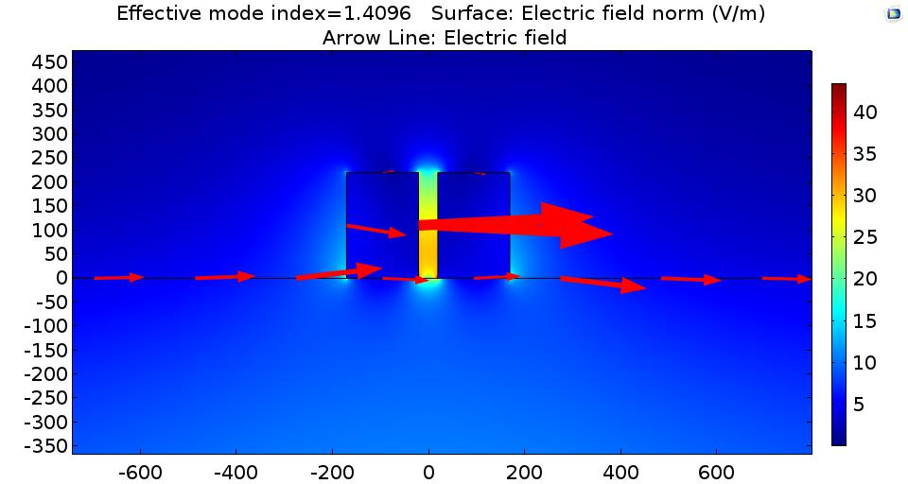
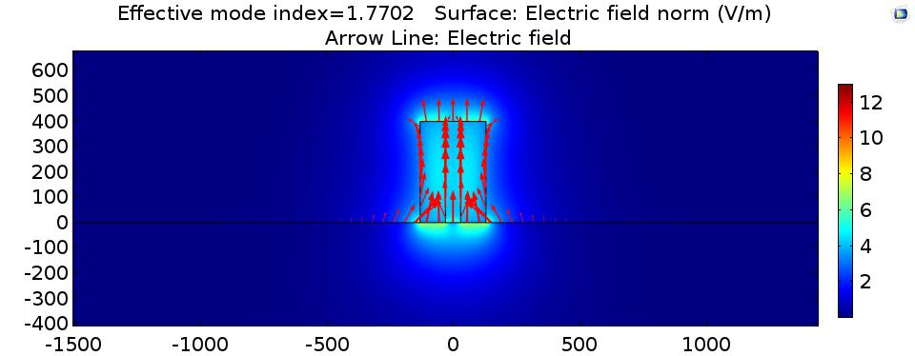
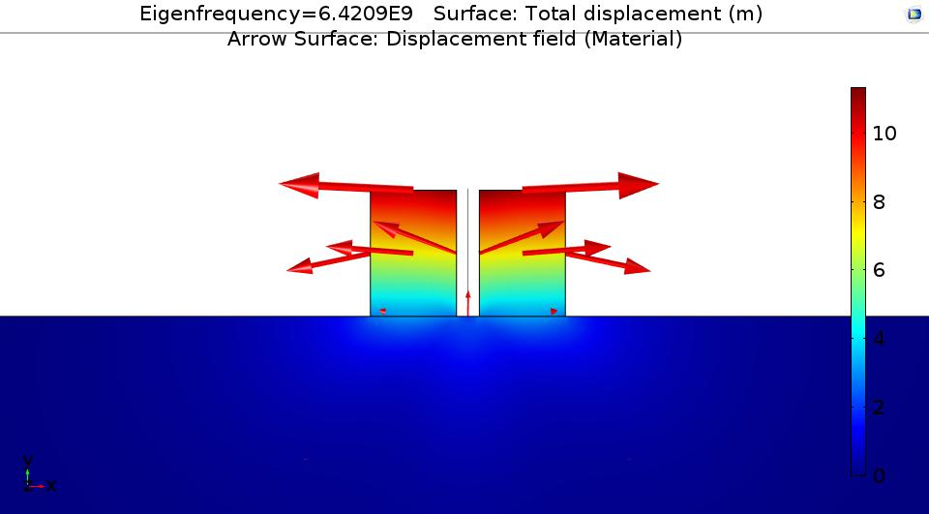
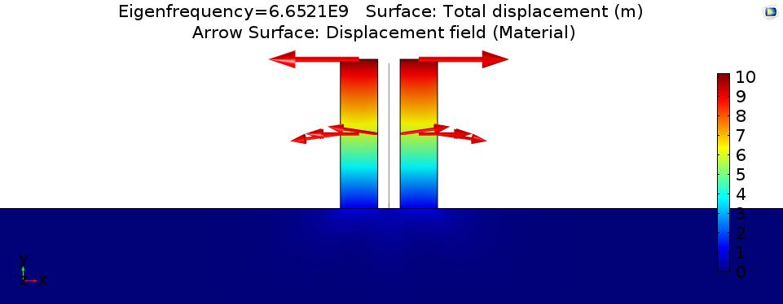
Geometries variations for Slot WG BSBS gain calculation
TE
TM
Anti symmetric

Slide 2
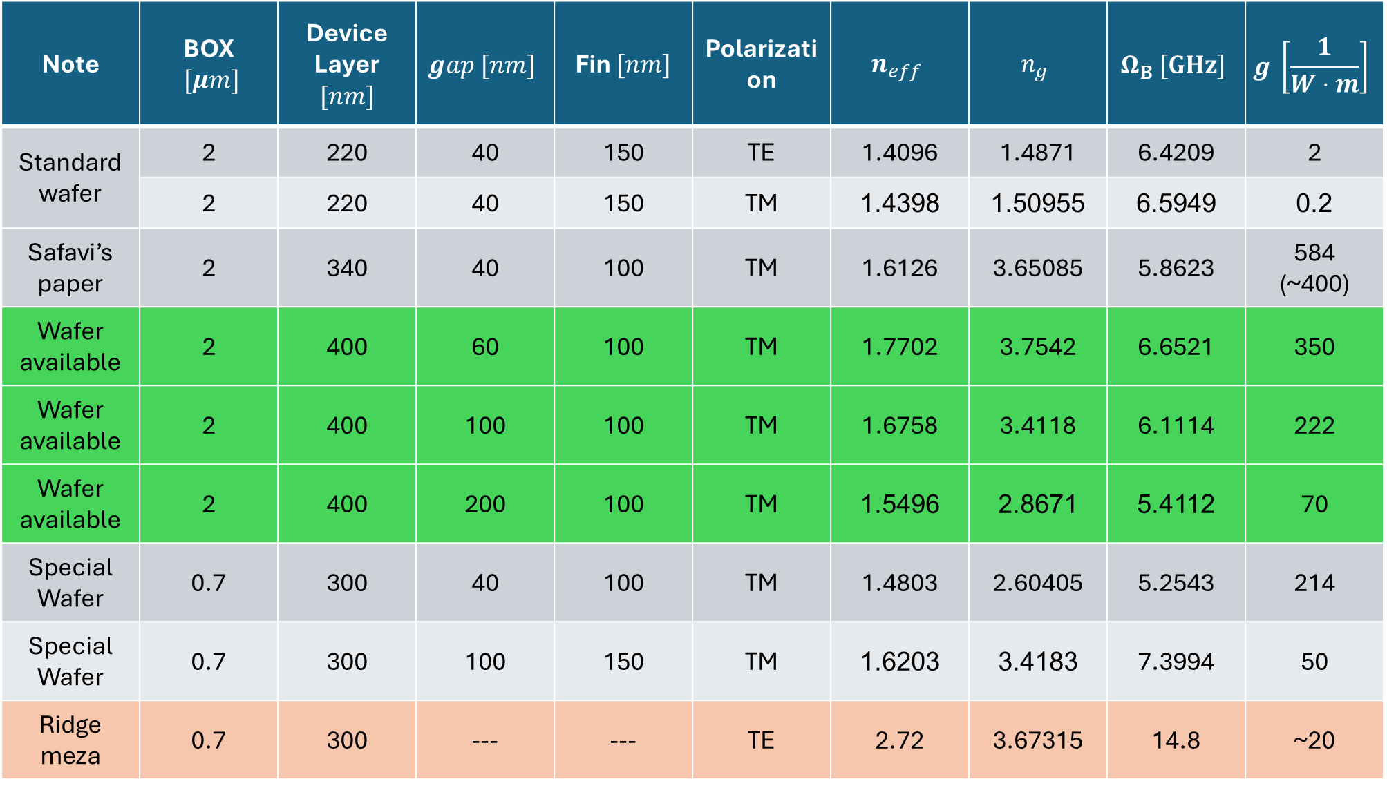
$$g \left[\frac{1}{W⋅m}\right]$$ | $$Ω_{B} [GHz]$$ | $$n_{g}$$ | $$n_{eff}$$ | Polarization | Fin $[nm]$ | $$gap [nm]$$ | Device Layer $[nm]$ | BOX $[μm]$ | Note
2 | 6.4209 | 1.4871 | 1.4096 | TE | 150 | 40 | 220 | 2 | Standard wafer
0.2 | 6.5949 | 1.50955 | 1.4398 | TM | 150 | 40 | 220 | 2
584 (~400) | 5.8623 | 3.65085 | 1.6126 | TM | 100 | 40 | 340 | 2 | Safavi’s paper
350 | 6.6521 | 3.7542 | 1.7702 | TM | 100 | 60 | 400 | 2 | Wafer available
222 | 6.1114 | 3.4118 | 1.6758 | TM | 100 | 100 | 400 | 2 | Wafer available
70 | 5.4112 | 2.8671 | 1.5496 | TM | 100 | 200 | 400 | 2 | Wafer available
214 | 5.2543 | 2.60405 | 1.4803 | TM | 100 | 40 | 300 | 0.7 | Special Wafer
50 | 7.3994 | 3.4183 | 1.6203 | TM | 150 | 100 | 300 | 0.7 | Special Wafer
~20 | 14.8 | 3.67315 | 2.72 | TE | --- | --- | 300 | 0.7 | Ridge meza

